Slide 1

Forest—Seekrtech的成功之路
汇报人：软件2001 20206722 柳成林
时间：2022.5.22

Slide 2
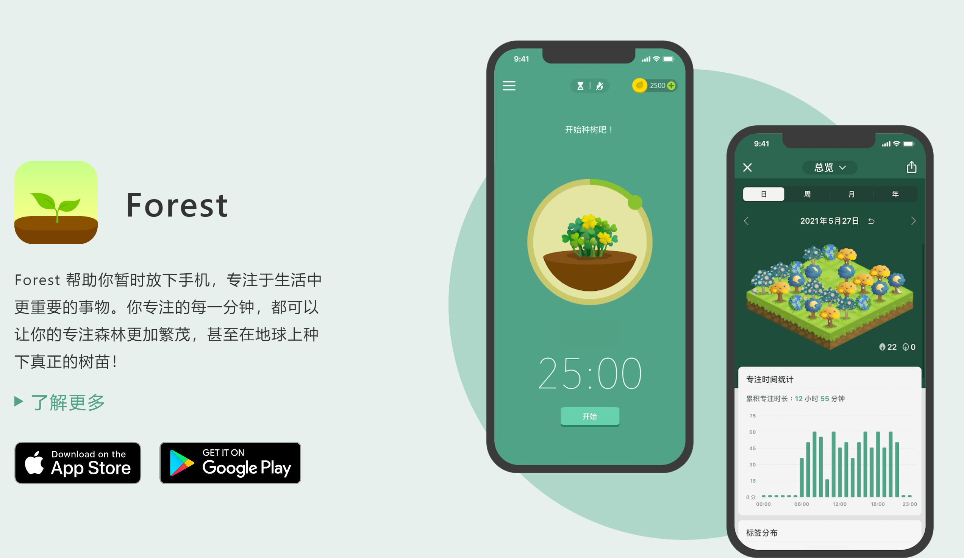

项目介绍
Developed by Seekrtech
Forest is an efficiency software that helps users temporarily put down their phones and concentrate on their current work. When using forest, the user should first set the focus time, click start, plant the corresponding length of the tree, in the next set time gradually grow into a large tree, if you leave The Forest to switch other pages to use the phone, the small tree will wither, success will get the corresponding gold coins, the user can get a tree in reality through the gold coins obtained or buy other tree species and background sounds.

Slide 3


行业分析
行业背景
How was Forest born?
The Internet is developing rapidly, and people cannot focus on learning People desperately need to control their phones There is an urgent need to improve efficiency
Forest—born

Slide 4
行业分析
产品优势
A sense of accomplishment
The user can complete the task and plant a tree If it fails, the tree will wither
Eco-efficiency
Protect the environment by planting real trees
竞争
优势
Improve user stickiness
Users can get gold coins by planting trees Coins can unlock new tree species, as well as real trees
Product innovation
Completing tasks by planting trees is an unprecedented innovation

Slide 5
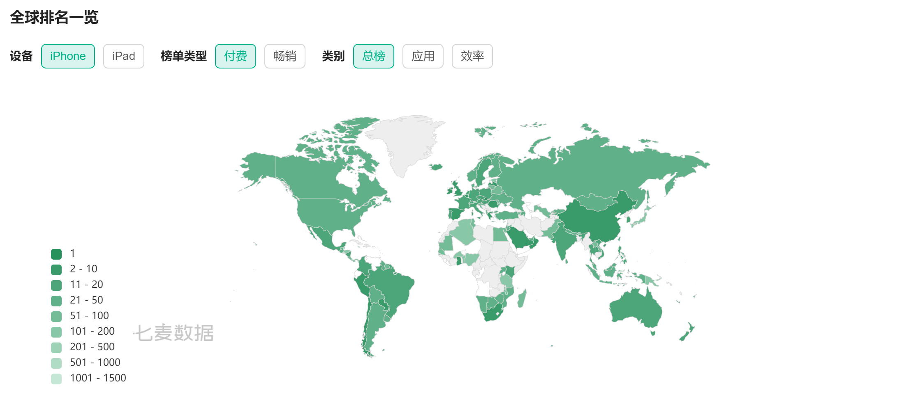
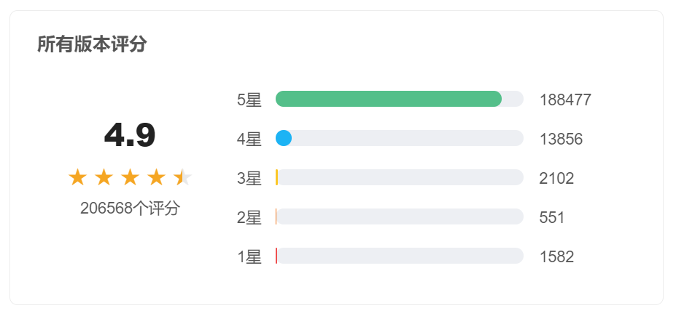
前景分析
The app is a paid app, and users can use it permanently after spending 12 yuan to buy the app. Forest has grown rapidly since its release on May 10, 2014. As of April 14, 2020, it has been used in 136 countries, with more than 4 million paying users, and has received significant revenue. As of May this year, 1.3 million real trees have been planted on the platform. In China, Forest ranks first in real time in the personal efficiency category, with an average score of 4.9, ranking first in the same category of efficiency products. From a global perspective, Forest has a wide range of user segments and a relatively high ranking list with good development prospects.

Slide 6
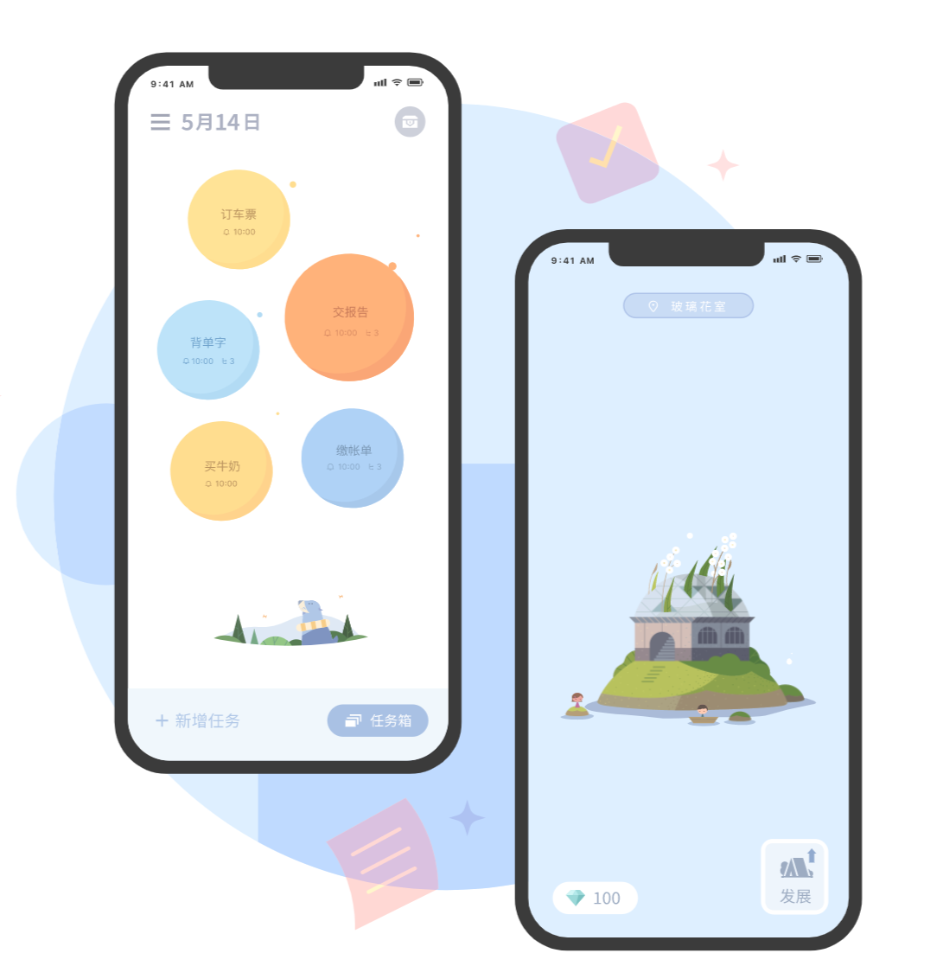
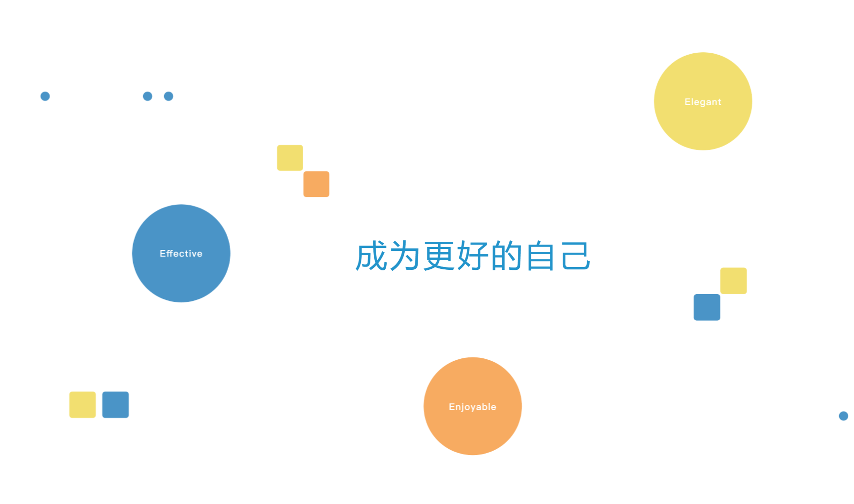
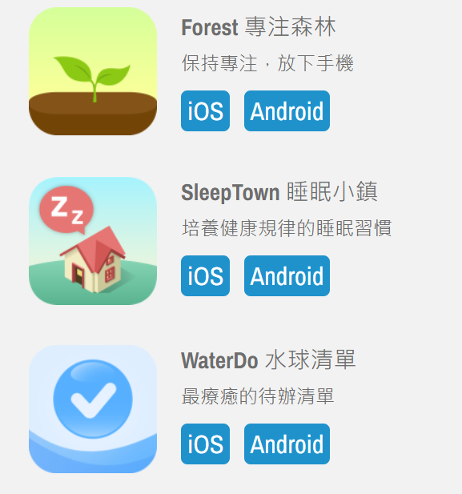
Seekrtech公司的成功之路：创业军规
创新是最好的创业武器
用文化带队伍
Innovative Idea – Planting Trees The aesthetics and operability of its interface also brings an excellent user experience;
Other innovative apps: SleepTown,WaterDo
Insist on bringing an efficient experience to users in a fun-filled way Excellent corporate culture

Slide 7
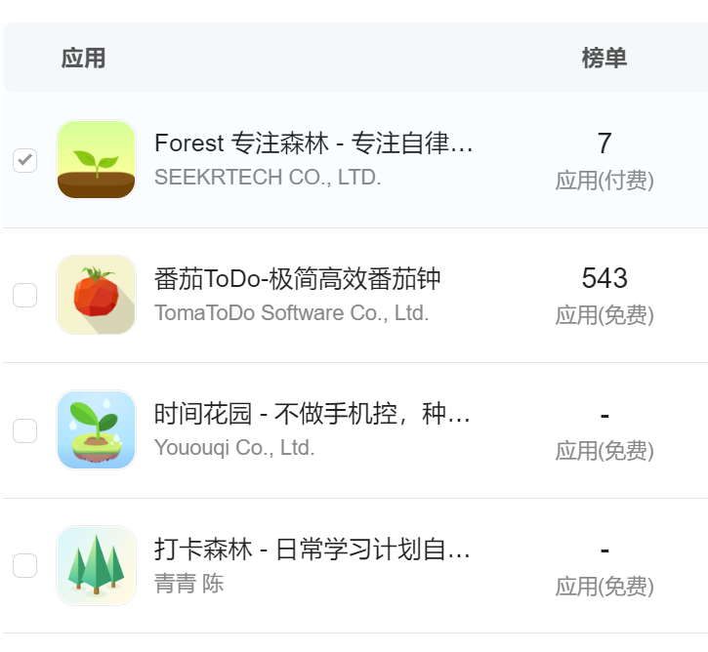
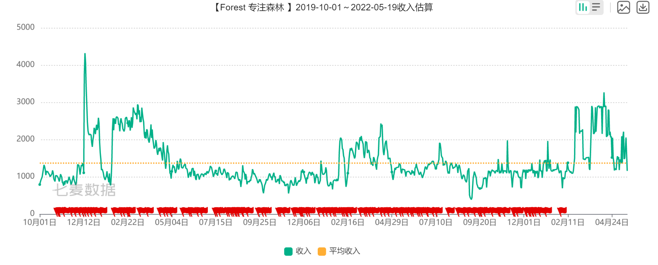
风险分析与设想
市场风险——心力强大者胜
心力强大者胜：It is undeniable that while Forest's revenue has risen a lot in 2022, there has been a long period of revenue downturn in the previous period. In recent years, efficiency apps have sprung up in large numbers, and products of the same category have emerged in the market. Forest is under strong competitive pressure, and if it wants to survive in the current situation, it must be done - strong heart. All competitions are ultimately a contest of mental strength, and all successful people are people with strong mental strength. Based on the above analysis, this risk is controllable.

Slide 8
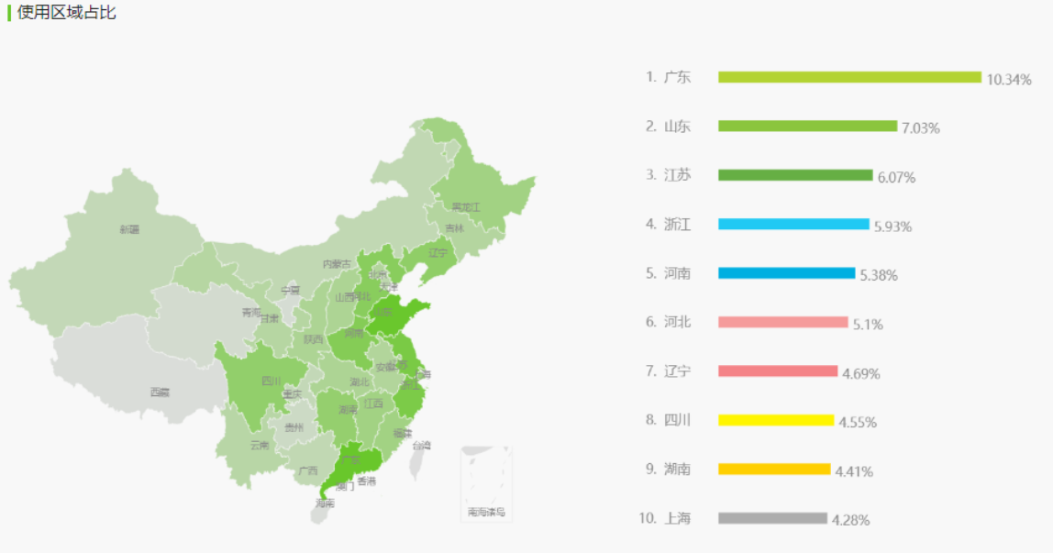
风险分析与设想
宣传力度
The survey found that Forest's publicity in the mainland is relatively insufficient, and a large number of people have not heard of this app, and if they master the publicity, they can grasp more markets. Forest can increase advertising investment, such as increasing publicity on the App Store homepage, or combining the tree planting function in the software to cooperate with the following environmental associations to increase the visibility of the product, Seekrtech's other products can also use similar methods to increase publicity. Based on the above analysis, this risk is controllable.

Slide 9

风险分析与设想
建设风险——先赚到钱在考虑发展
好的商业模式是成功的一半；先赚到钱在考虑发展 At present, the way to make a profit for the product is mainly to directly purchase the app itself, and has paid for the purchase of gold coins internally. Considering that some users may refuse to buy when they see a paid app, you can consider investing the app in free and adding internal paid functions. For example, advertising fees, the establishment of cooperative relations; value-added service fees, after the development of the project matures, other educational projects can be opened. Based on the above analysis, this risk is controllable.

